Slide 1

BIG DATA IN RETAIL INDUSTRY
BY: NIKSHITA RANGANATHAN
Shop now!

Slide 2
”
—Andrew McAfee
“The world is one big data problem.”

Slide 3
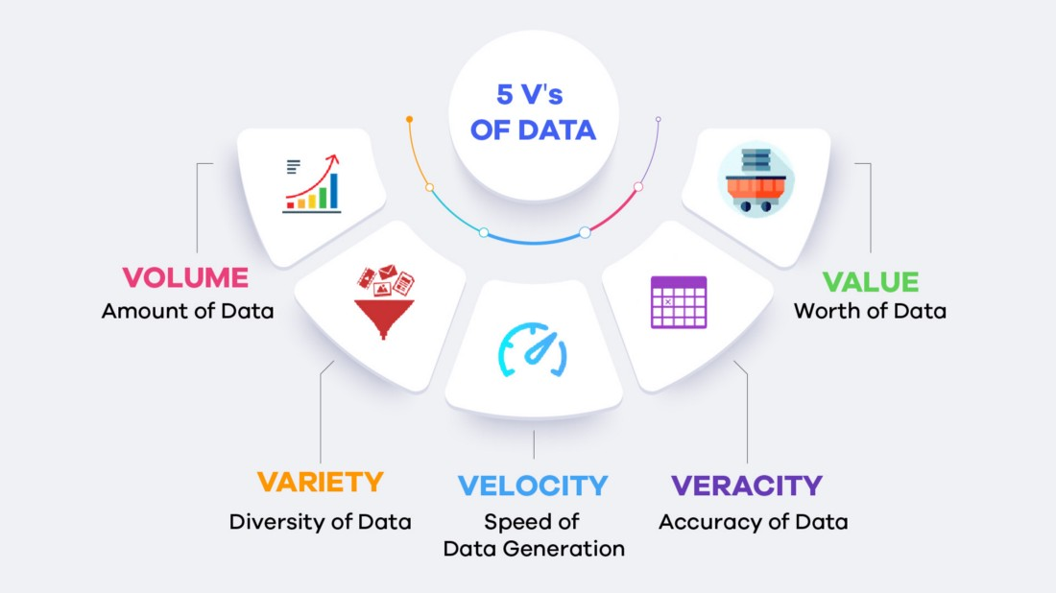
BIG DATA
Big Data is made up of 5 Vs
Essential Vs
Volume
Velocity
Variety
Traditional Vs
Veracity
Value
Fun Facts :
If you burned all of the data created in just one day onto DVDs, you could stack them on top of each other and reach the moon – twice.
Poor data across businesses and the government costs the U.S. economy $3.1 trillion dollars a year

Slide 4

BENEFITS OF BIG DATA IN RETAIL INDUSTRY
01
03
05
Anticipate supply chain disruption
Forecasting Demand
Personalizing Customer Experience
Optimizing Pricing
Customer journey analytics
02
04

Slide 5
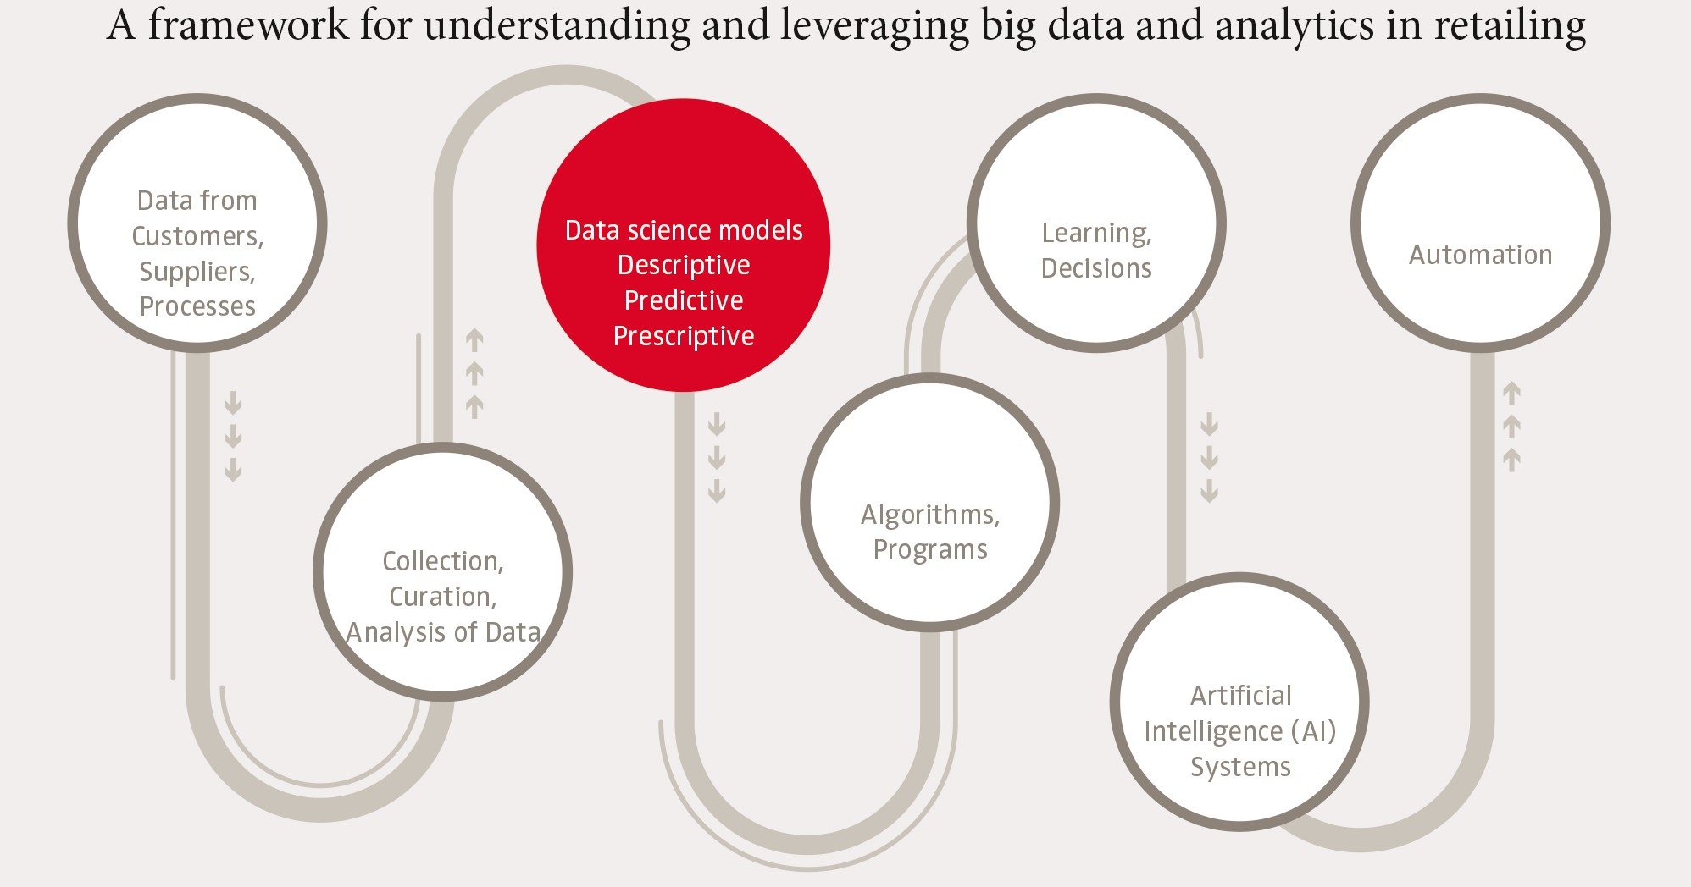
UNDERSTANDING THE PROCESS
C
AI assisted decisions are automated
A
Customer data from various sources are gathered in cloud environment
B
Programs and Algorithms are created for models to learn about the stored data
SOURCE : https://www.nim.org/en/publications/gfk-marketing-intelligence-review/all-issues/future-retailing/big-data-and-analytics-retailing

Slide 6
BIG DATA CHALLENGES IN RETAIL
A
C
Shortage of Skilled Personnel in Big Data Analytics
Required Data cannot be found easily
B
D
Data Security is ignored
Collection of inaccurate & outdated data

Slide 7

HOW THESE CHALLENGES CAN BE SOLVED?
01
02
Adequate training to the team
Review the existing data management procedure
03
04
Implement a new & sound data management approach
Integrate the database

Slide 8

WHAT ARE THE BIG DATA SOURCES IN RETAIL?
C
Devices
B
Social Media
D
Internet-of-Things
A
Enterprise systems (Large-scale)
E
Public Data

Slide 9
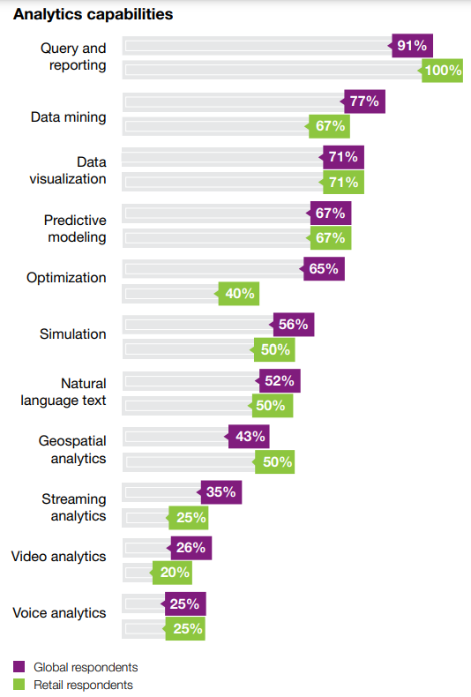

ANALYTICAL TOOLS & SOFTWARES USED IN RETAIL
Business Intelligence Tools – Tableau, PowerBI
Sales Forecasting Softwares – Market research, Last year data to estimate sales
Demand Forecasting Softwares - MS Excel with statistical models, Generic statistical modelling
Unified Advanced Retail Analytics – Customized analytics software
Graph depicting that Retailers are on par with other industries in their use of analytics
SOURCE : https://www.ibm.com/downloads/cas/VXOJQW1L

Slide 10
REAL-LIFE BIG DATA EXAMPLES
RETAIL ORGANIZATIONS

Slide 11



STARBUCKS
26% Revenue rise from 2016-2019
Produces marketing incentives, customized products & aftercare services to attract customers
Used Big data to estimate performance of stores in different locations

Slide 12


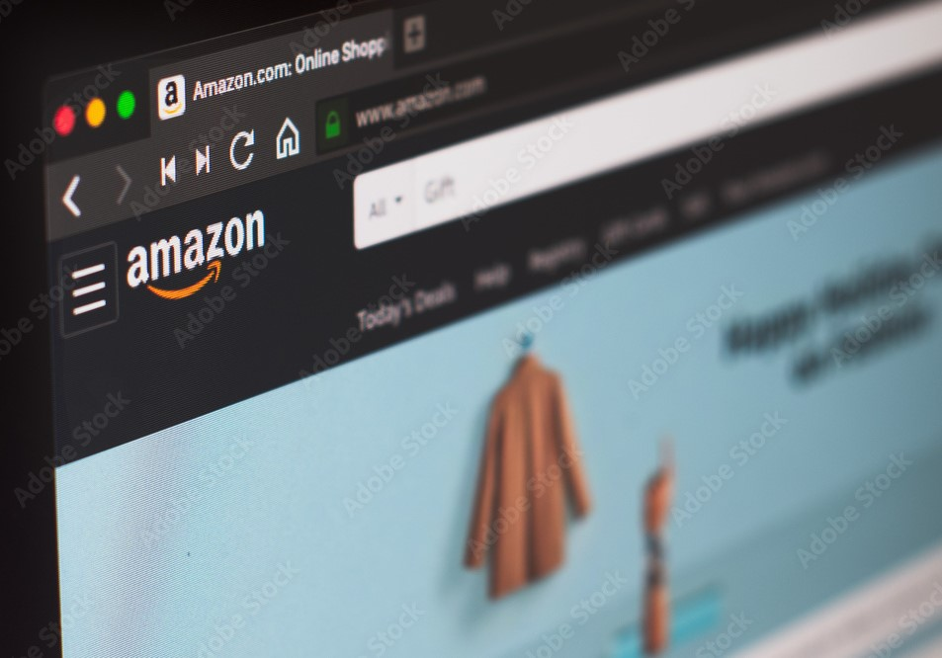
AMAZON
Advanced recommendation engine
Recommendations contribute 35% of Amazon's revenue.
Boosts sales of slow-moving products

Slide 13



IKEA
Initiated approaches for sustainable future
Complementary product suggestions
Introduced Augmented reality and Image recognition in the app

Slide 14
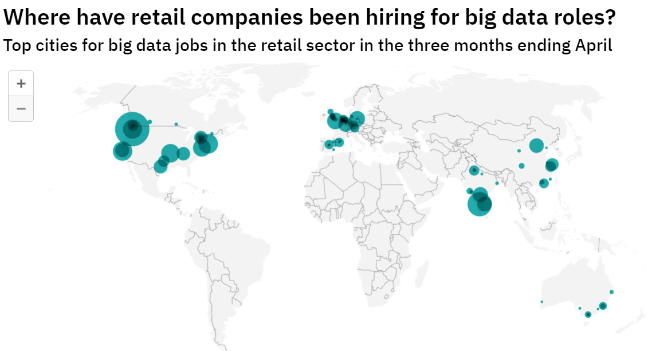
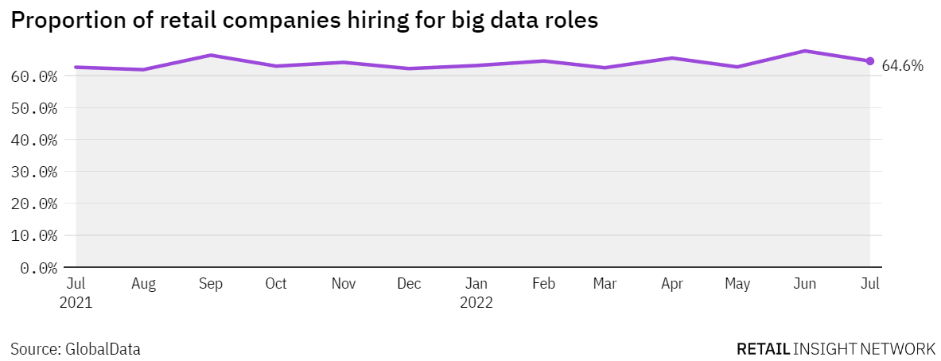
RETAIL OVERVIEW
Seattle (US) - 10.5%
New York City (US) - 3.1%
Bengaluru (India) - 5%
Sunnyvale (US) - 3.1%.
64.6% hiring rate in Jul 2022

Slide 15
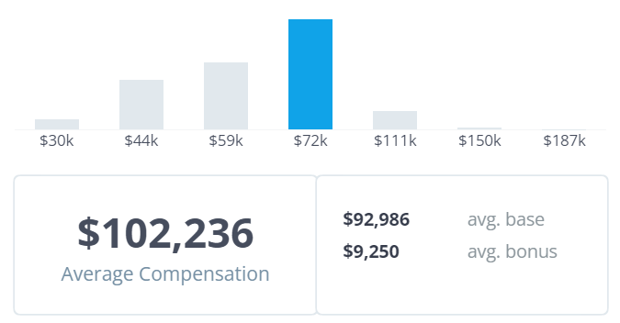
AMAZON – DATA ANALYST
Work with cross-functional teams to offer research and business areas insights.
AVERAGE DATA ANALYST SALARY IN AMAZON
Helps bridge the gap between data & decision-making
SOURCE: https://www.comparably.com/companies/amazon/salaries/data-analyst

Slide 16
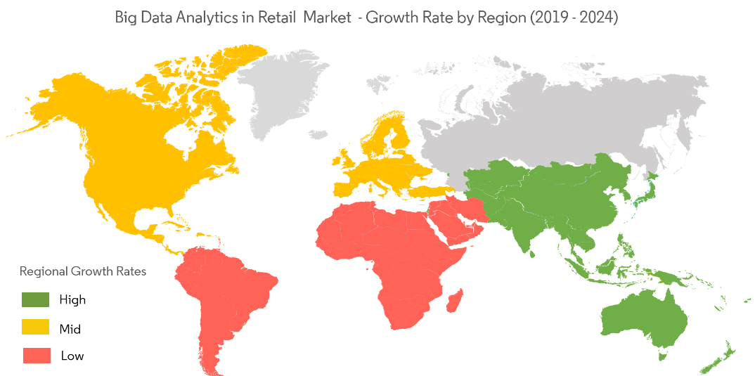
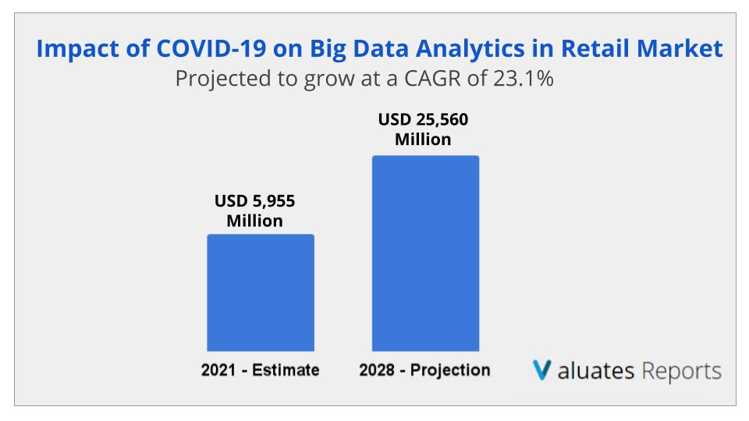
MARKET FORECAST
COVID-19 pandemic has a positive impact on retail market
Due to increase in usage of big data for understanding the spread of the virus

Slide 17
REFERENCES
Marotta, D. (2022, February 15). Retail Revolution: The Role of Big Data Analytics in Retail. Hitachi Solutions. Retrieved October 22, 2022, from https://global.hitachi-solutions.com/blog/retail-analytics/
Data Journalism Team. (2022, June 7). Asia-Pacific is seeing a hiring boom in retail industry big data roles. Retail Insight Network.
Retrieved October 22, 2022, from https://www.retail-insight-network.com/analysis/asia-pacific-is-seeing-a-hiring-boom-in-retail-industry-big-data-roles/
Stoycheva, Z. (n.d.). How do global retail leaders use Big data? (5 real-life examples).
Retrieved October 22, 2022, from https://blog.datumize.com/how-do-global-retail-leaders-use-big-data-5-real-life-examples
Retalon. (2022, September 23). 23 Sep Ultimate Guide to Retail Analytics (Definition, Types, Examples, Tips). Retrieved October 22, 2022, from https://retalon.com/blog/retail-data-analytics

Slide 18
THANK YOU

